Slide 1
AR LIBRARY BASED APP USING UNITY 3D
AARTHI R (REG.NO: 211418104002)
AISHWARYA C (REG.NO: 211418104008)
ANNIE DIVYA D (REG.NO: 211418104021)
PROJECT GUIDE: Mrs. A.KANCHANA M.E Assistant Professor

Slide 2
INTRODUCTION
Traditional earlier systems for book tracking in the library make use of static desktop computing with database systems that only had the classification call numbers of the books rather than providing any more guidance to users for services and spatial awareness. Owing to this fact, many constraints become more apparent, students might be confused about the location of the resources and their own location after querying in the library system until he/she ask to the librarian staff to look up the shelf numbers or by doing manually by searching each shelf by his own, of course this is time- consuming. But the fact is that not every user will ask about how to use and search for material; it was found that 75 to 85 percent of students using library with research purposes described in terms of fear and confusion their initial response to library research. Augmented reality is a relatively new field of technology, only recent years it has become so popular on account of new development platforms. Augmented Reality (AR) is one of the most promising contemporary technologies that has the potential to utterly change how people react with the real world, practically transforming reality to an enhanced digital environment full of interesting and useful information. Augmented reality like most of established technologies can be used in every field of day- to-day life. The attraction of augmented reality is its simplicity.

Slide 3
LITERATURE SURVEY
TITLE | AUTHOR | METHODOLOGY | MAJOR FINDINGS
Spatial augmented reality based customer satisfaction enhancement and monitoring system | Udaya dampage ,D.A Egodagamage (2021) | Spatial augmented reality | The SAR technology mostly uses 3D visualization,which attempts to show by projecting 3D information onto a 2D plane.
Virtual reality and augmented reality in social learning spaces | Ali Arya , Robert J. Teather. (2020) | VR/AR educational platforms | It is the overview of the use of VR AND AR within a social education context.
Rendering optimization for mobile web 3D based on animation data separation and on-demand loading | Liang Li , Xiuquan Qiao , Pei Ren. (2020) | Animated data separation and on demand loading | This method improves the quality of the user interaction experience by reducing the amount of data loaded initialy .
3D model interaction | Shabnam shahreen sitaf and Ali Shihab sabbir (2019) | 3D model interaction | Interaction mode , provides a more intuitive and efficient means of information.
Active visitor: augmenting libraries into social spaces | Zois Koukopoulos , dimitrios koukopoulos | Augmenting libraraies into social spaces | Provide services to library visitors aiming at the optimization of user experience during a library visit.
A mobile intelligent training system for ATM | Yongjun Qiao , Xiaofang Xie , Tao Sun (2018) | Mobile intelligent training system | the interactive and virtual experience that the user can dispatch money from ATM without touching the keypad.
Mobile augmented reality survey: from where we are to where we go | Dimitris Chatzopoulos , Carlos Bermejio , Zhanpeng Huang, and Pan Hui (2017) | Mobile augmented reality | Combines real and virtual objects in a real environment, this is interactive in real time.
The augmented library :An approach for improving user awareness in a campus library | Albert A. Cervera-Uribe(2017) | Augmented library | Provide an AR shelf searching system (ARSSS) which enables users to navigate and search for materials.

Slide 4
PROBLEM STATEMENT
Many libraries make use of passive and fixed signs, such as floor plans and call numbers, in order to bring some guidance to the users. However, these indications are not fully functional since they do not provide personal aid for students that requires a specific material or service norm for newcomers that might be confused about their own location while looking for resources at the library. Although there exist a number of augmented reality applications specially designed for the users of libraries, their number is limited. None of them got ready for the market and some of them, even discontinued. This might be due to an immature technology, financial issues, a lack of acceptance among users or a lack of acceptance among librarians. To identify the potential of augmented reality apps in libraries we will focus on the point of view of libraries. To create an interactive library management system that can be used to make library more appealing. AR offers a strategic medium through which librarians can attach additional digital information to real-world objects and simply let users interact with them. This application can reduce the complexity of managing a library.

Slide 5
DEVELOPMENT ENVIRONMENT
HARDWARE ENVIRONMENT:
Android Mobile.
Processor-Intel®Core™i3-6006U CPU @2.00GHz, 4 GB RAM,
NVIDIA GeForce MX330
SOFTWARE ENVIRONMENT:
Unity 3D
Vuforia
Android Studio

Slide 6
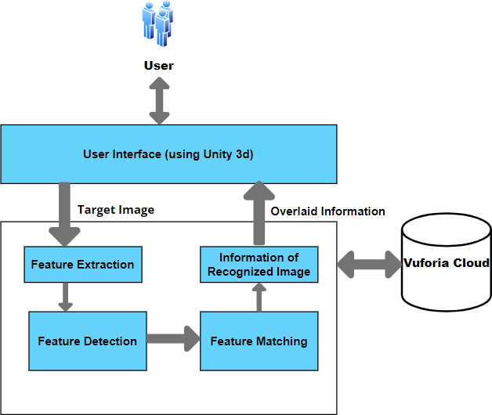
SYSTEM ARCHITECTURE:

Slide 7
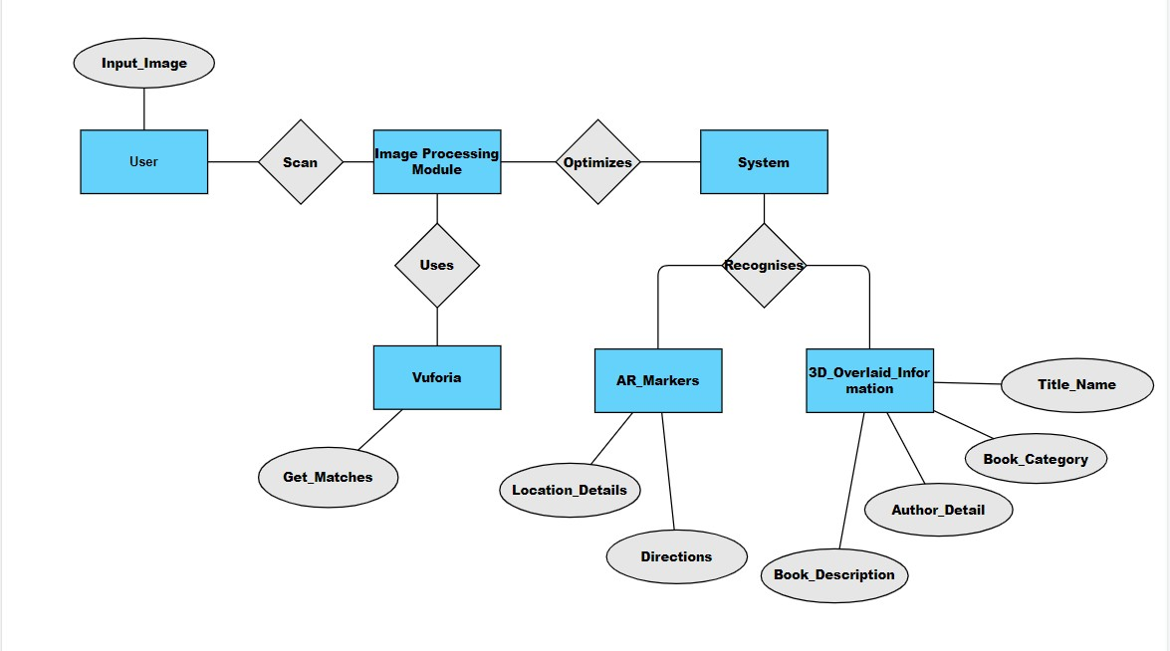
ER DIAGRAM

Slide 8
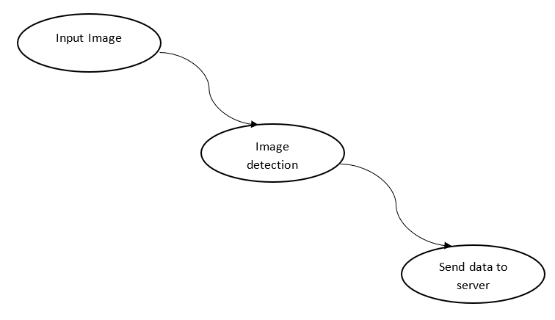
DFD DIAGRAM
user
Server
start
Display all the data
Image input
application
LEVEL 0 LEVEL 1 LEVEL 2

Slide 9
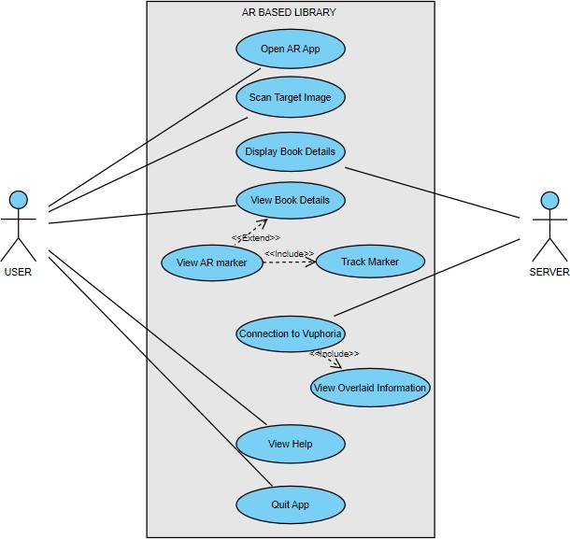
USE CASE DIAGRAM

Slide 10
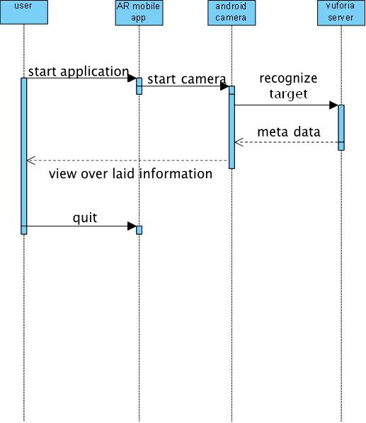
SEQUENCE DIAGRAM
SEQUENCE DIAGRAM

Slide 11
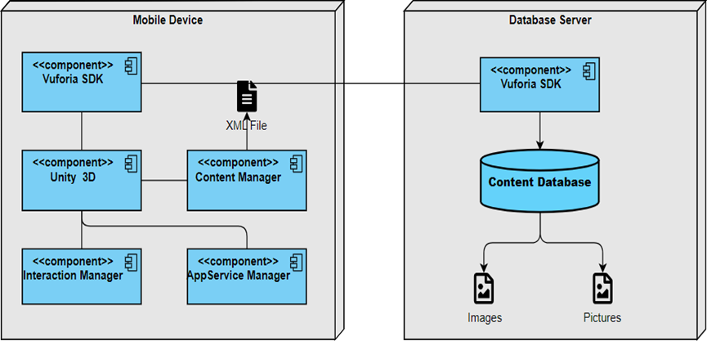
DEPLOYMENT DIAGRAM

Slide 12
MODULE DESCRIPTION
UNITY 3D
ANDRIOD STUDIO
VUFORIA
IMAGE PROCESSCING

Slide 13
MODULE DESCRIPTION
UNITY 3D
Unity is currently the most popular gaming engine used by developers around the world - and for good reason. It has a powerful visual interface for making games, cross platform development, and an active contributing community
Unity is a cross-platform game engine primarily used to develop video games and simulations for PC, consoles, mobile devices and websites
the window of Unity 3D is made up of small individual windows that can be rearranged, grouped in sets, detached from one position and docked back again, within the main window
“ARCamera” is an Augmented Reality camera prefab from Vuforia. Image Target is added to the scene.

Slide 14
ANDRIOD STUDIO
Android Studio is the official integrated development environment (IDE) for Google's Android operating system, built on JetBrains' IntelliJ IDEA software and designed specifically for Android development.
Android Studio supports all the same programming languages of IntelliJ (and CLion) e.g. Java, C++, and more with extensions, such as Go
VUFORIA
Vuforia is an augmented reality software development kit (SDK) for mobile devices that enables the creation of augmented reality applications.
To get started, Vuforia’s Developer Portal is set up, and an account is created. Once logged in, a developer page is available. A license key works as an ID to create an application in Unity using Vuforia.
This license key is created in the developer page with the help of a “License Manager”. Next, the “Target Manager” is used to add Image Target in Unity. This is done by adding an Image Target database and filling in the details.
Images are added to the newly made database. Vuforia supports various kinds of targets like a single flat image, cylindrical, cuboidal, 3D image, etc. Lastly, this Image target database is downloaded for importing into Unity. This is done with the help of the “Download Dataset”.

Slide 15
IMAGE PROCESSING
We are using Marker Recognizing for Image Processing.
MARKER RECOGNITION
Marker is an image (it could be anything) that can be uniquely identified and not be confused with other image as it will be the gateway through which virtual elements can be brought into the real world. The application is programmed to recognize the marker in an arbitrary scene and give details of its locations and orientation. To recognize a marker, the following steps are followed:
Input
Grayscale Conversion
Thresholding

Slide 16
TESTING
S.NO | SCENARIO | INPUT | EXPECTED OUTPUT | ACTUAL OUTPUT
1 | Add Target Image | Admin adds Target Image to Vuforia Cloud. | Admin adds target Image if Rating is above three ”Successfully added” or “Unsuccessful”. | Required five star rating for uploading target image.
2 | Open ARLib App and Scan | User Open’s the app and scan the Target Image. | If the Feature is extracted and then Feature Detection is “Successful” or “Unsuccessful” | Scanned and detected successfully or it’s not vaild.
3 | Image Processing | If the Feature is Detected Feature Matching is proceeded. | If Feature is Matched Properly List Of Books will be Augmented “Successfully” or it’s “Unsuccessful”. | Target Image Recognized and Matched successfully or Unsuccessful.
4 | Book Description and Location | If the Books are Listed the books details can be viewed. | If the Book Title is clicked the book detail, description and location is displayed “Successfully” or it’s “Unsuccessful”. | Select a book from list of books and it displays the book details if it’s successfully or it is Unsuccessful.

Slide 17
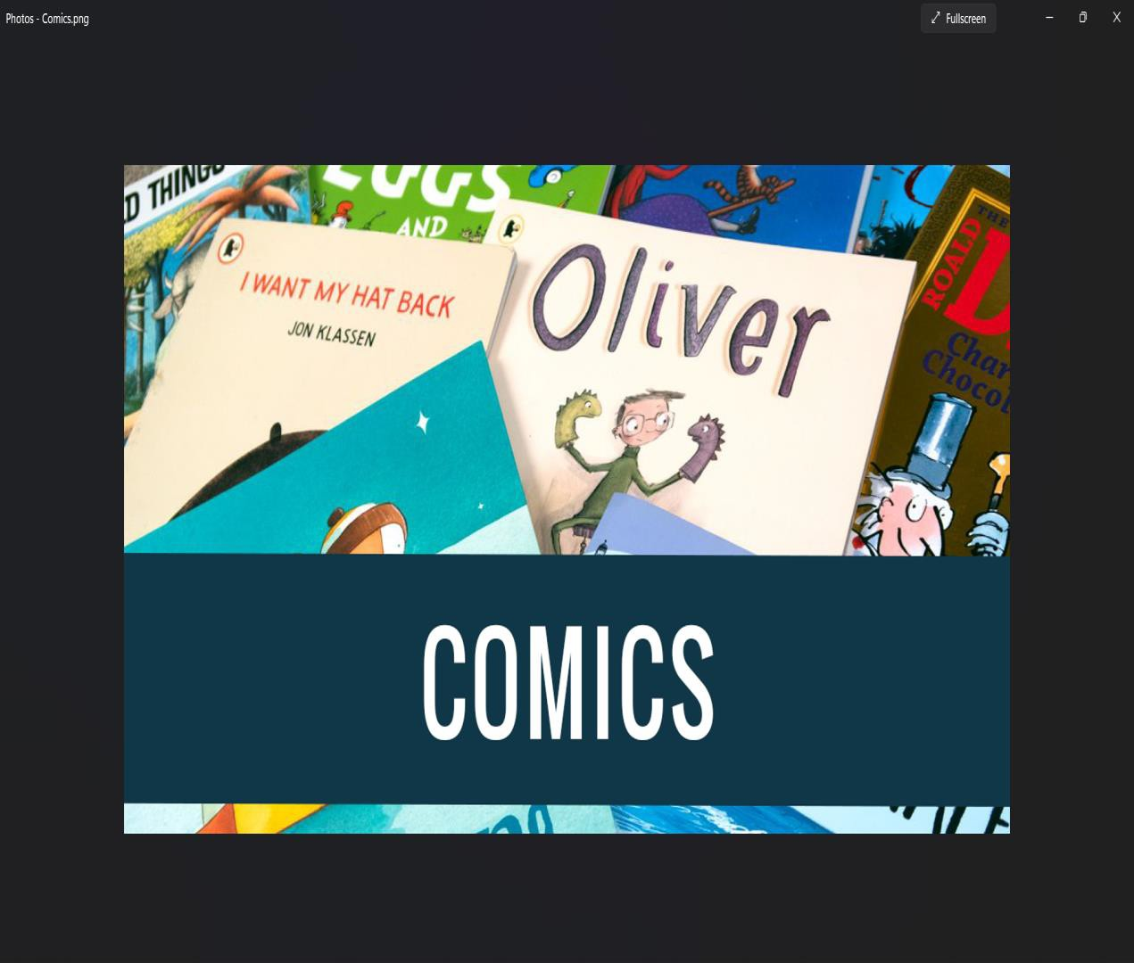
SCREEN SHOTS

Slide 18
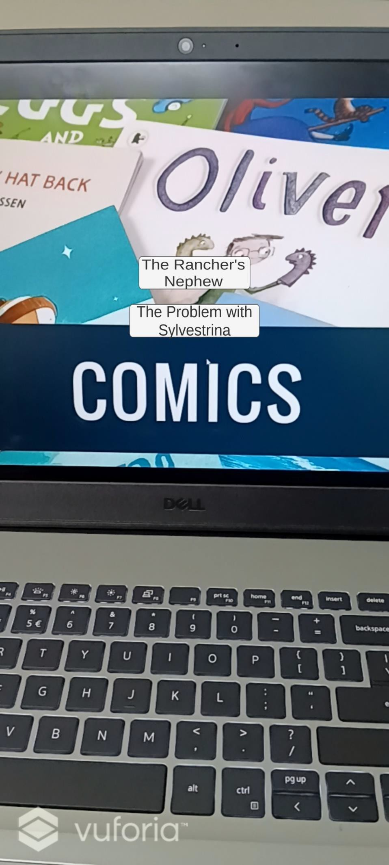

Slide 19
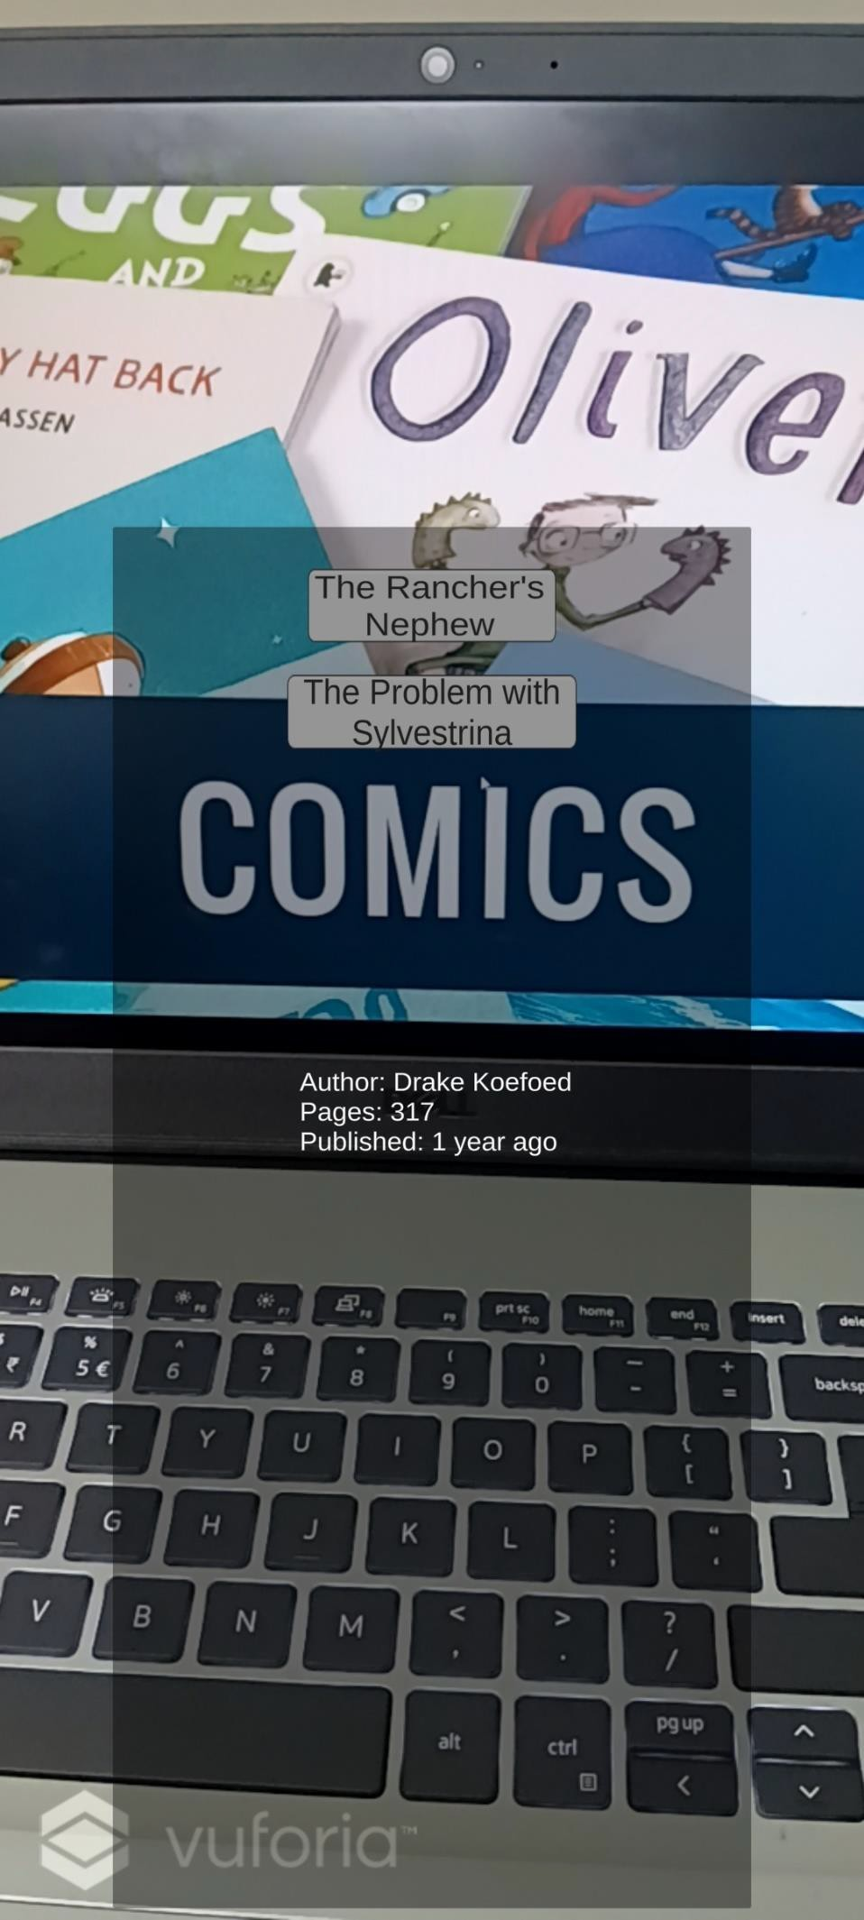

Slide 20
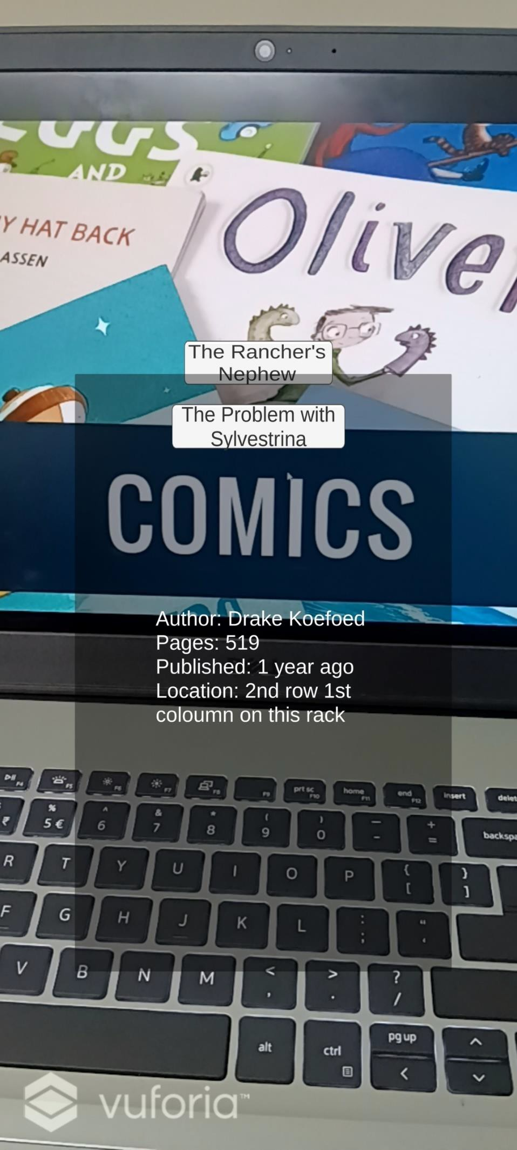

Slide 21
CONCLUSION
The system “AR LIBRARY BASED APP USING UNITY 3D” is implemented where a user can hover a camera over a page and obtain augmented information such as book details, or an explanation about that page. It is a system where no typing or searching is required for getting information. Since the application can be deployed on any smartphone, a student can use it as per his/her convenience. Also, there is no need of any extra maintenance for this application thus making it an economical solution. The interactivity aspect of this application like showing the overlaid information allows the user to understand the concept from every angle.

Slide 22
REFERENCES
[1] A. Syberfeldt, O. Danielsson, and P. Gustavsson, ‘‘Augmented reality smart glasses in the smart factory: Product evaluation guidelines and review of available products,’’ IEEE Access, vol. 5, pp. 9118–9130, 2017.
[2] X. Qiao, P. Ren, S. Dustdar, and J. Chen, ‘‘A new era for Web AR with mobile edge computing,’’ IEEE Internet Comput., vol. 22, no. 4, pp. 46–55, Jul. 2018.
[3] M. Makar, V. Chandrasekhar, S. S. Tsai, D. Chen, and B. Girod, ‘‘Interframe coding of feature descriptors for mobile augmented reality,’’ IEEE Trans. Image Process., vol. 23, no. 8, pp. 3352–3367, Aug. 2014.
[4] T. Engelke, M. Becker, H. Wuest, J. Keil, and A. Kuijper, ‘‘MobileAR browser—A generic architecture for rapid AR-multi-level development,’’ Expert Syst. Appl., vol. 40, no. 7, pp. 2704–2714, Jun. 2013.
[5] D. Chatzopoulos, C. Bermejo, Z. Huang, and P. Hui, ‘‘Mobile augmented reality survey: From where we are to where we go,’’ IEEE Access, vol. 5, pp. 6917–6950, 2017.
[6] Udaya Dampage, D.A.Egodagamage “Spatial Augmented Reality Based Customer Satisfaction Enhancement and Monitoring System”,IEEE Access, vol. 9, pp. 97990,2021.
[7] Ali Arya, Robert J. Teather “Virtual reality and augmented reality in social learning spaces: a literature review” , Springer 2020.
[8] Liang Li , Xiuquan Qiao , Pei Ren “Rendering Optimization for Mobile Web 3D Based on Animation Data Separation and On-Demand Loading”, IEEE Access, vol. 8 ,pp. 88474,2020.
[9] Shabnam Shahreen Sifat and Ali Shihab Sabbir “3D model interaction”, ,2019.
[10] Zois Koukopoulos, Dimitrios Koukopoulos “Active Visitor: Augmenting Libraries into Social Spaces”, IEEE Xplore,2019.
[11] Yongjun Qiao , Xiaofang Xie , “Tao Sun A Mobile Intelligent Training System for ATM”, 2018.
[12] Dimitris Chatzopoulos, Carlos Bermejo, Zhanpeng Huang, And Pan Hui
“Mobile Augmented Reality Survey: From Where We Are to Where We Go”, IEEE ACCESS , vol 5, pp.6917 ,2017.
[13] Albert A Cervera-Uribe ”The Augmented Library: An Approach for Improving Users Awareness in a Campus Library”, IEEE Computer Society, 2017.

